Slide 1
P163 : GROUP - 2
1. Mohammed Faisal Khan 2. Sampada Shankar Dudhane

Slide 2

PROJECT ON STOCK MARKET DATA ANALYSIS
The entire idea of predicting stock price is to gain significant profits.

Slide 3
Stock Market Price Prediction
What is Stock Market? A stock market is a public market where you can buy and sell shares for publicly listed companies. The stock market also known as equity market or share market represent ownership in company such as shares of private companies which are sold to investors through equity crowdfunding platforms and the stock exchange is the mediator that allows the buying and selling of shares. Why Stock Price Prediction? *Stock price prediction using machine learning helps us to discover the future value of company stock and other financial assets traded on an exchange *The entire idea of predicting stock prices is to gain significant profits. *The idea is to weigh out the importance of recent and older data and determine which parameters affects the ‘present’ or ‘next’ day prices the most.

Slide 4
1. Dataset: JSWSTEEL_STOCK_PRICE

Slide 5
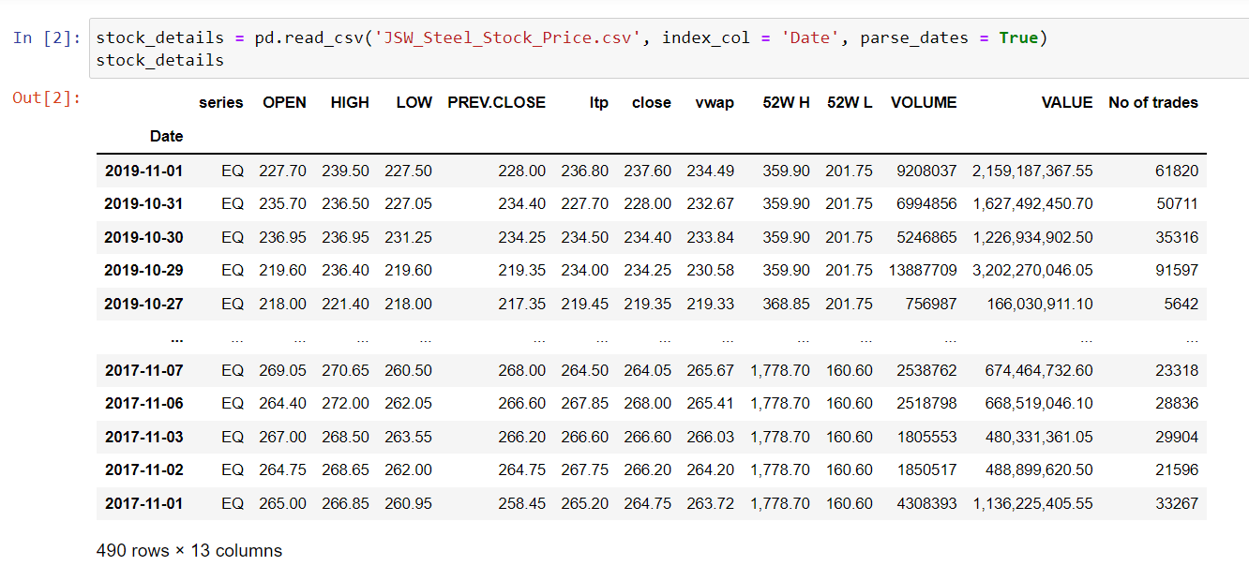

Slide 6
About Dataset : The JSW STEEL dataset has information of 2 Years from 1 Nov 2017 to 1 Nov 2019. There are 12 columns. * Open column tells the price at which a stock started trading when the market opened on a particular day. * Close column refers to the price of an individual stock when the stock exchange closed the market for the day. * The High column depicts the highest price at which a stock traded during a period. * The Low column tells the lowest price of the period. * Volume is the total amount of trading activity during a period of time. * LTP refers to last trade price at which a stock was traded in market. * VWAP - The volume-weighted average price that shows the average price of a security adjusted for its volume. * 52W H - refers to a highest price that the stock has traded over a 52 week period i.e. a year. * 52W L - refers to a lowest price that the stock has traded over a 52 week period i.e. a year.

Slide 7
2. Data Understanding

Slide 8
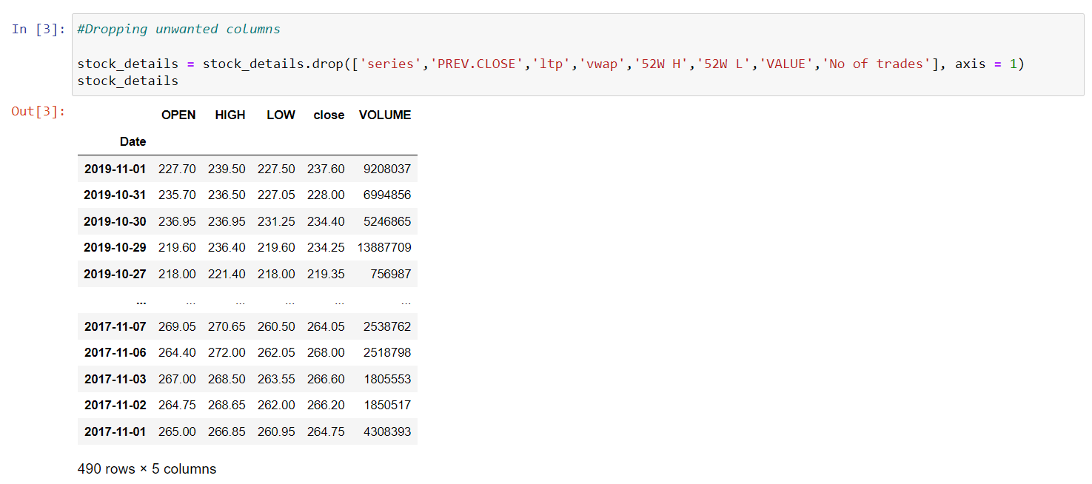
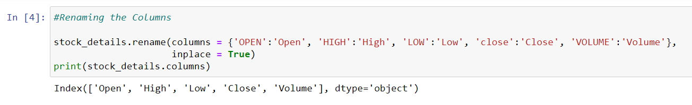
2.1 Initial Analysis :

Slide 9
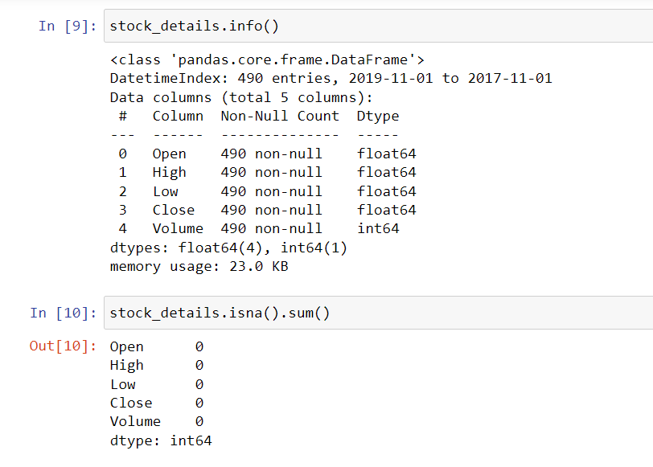
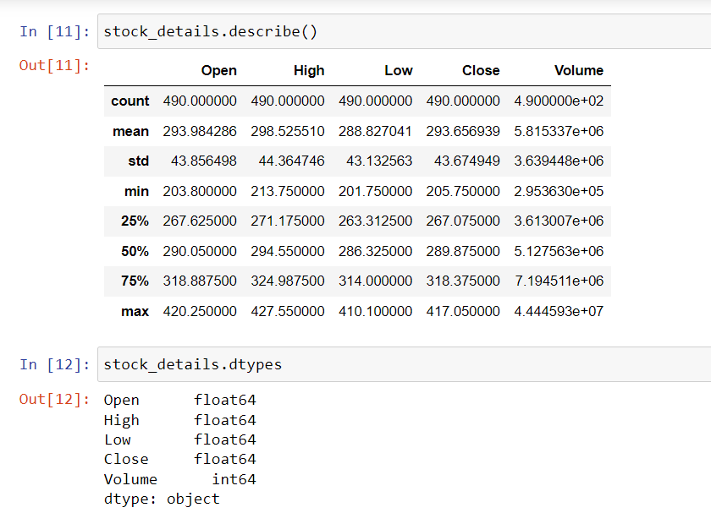

Slide 10
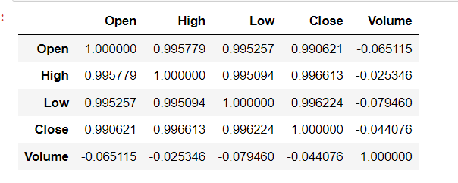
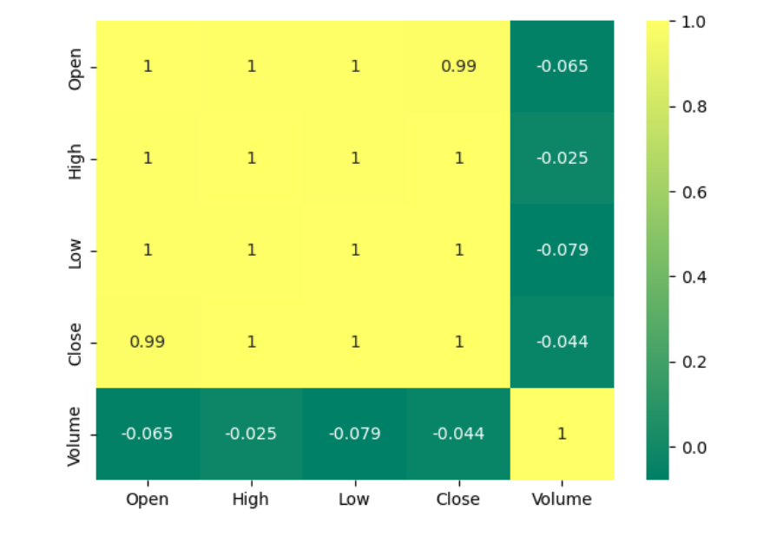
2.2 Correlation Matrix :

Slide 11
3. Data Visualization

Slide 12
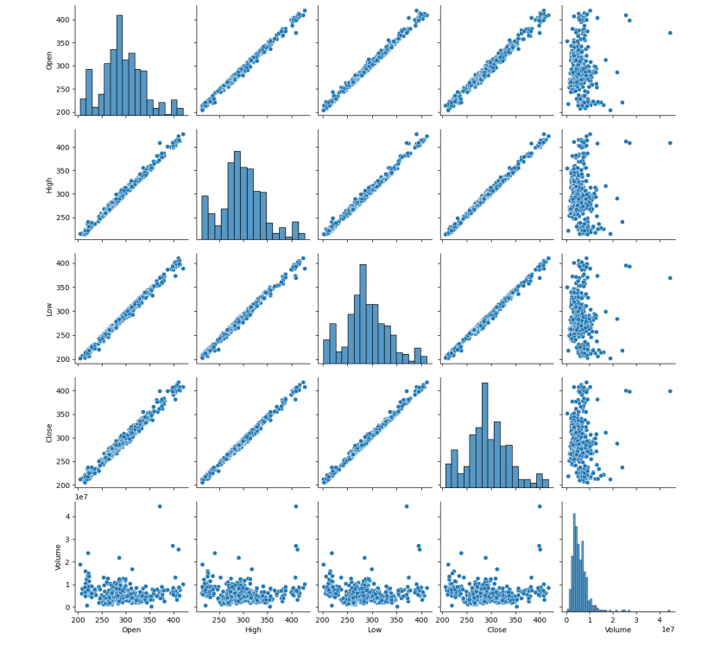
3.1 Using Pair Plot :

Slide 13
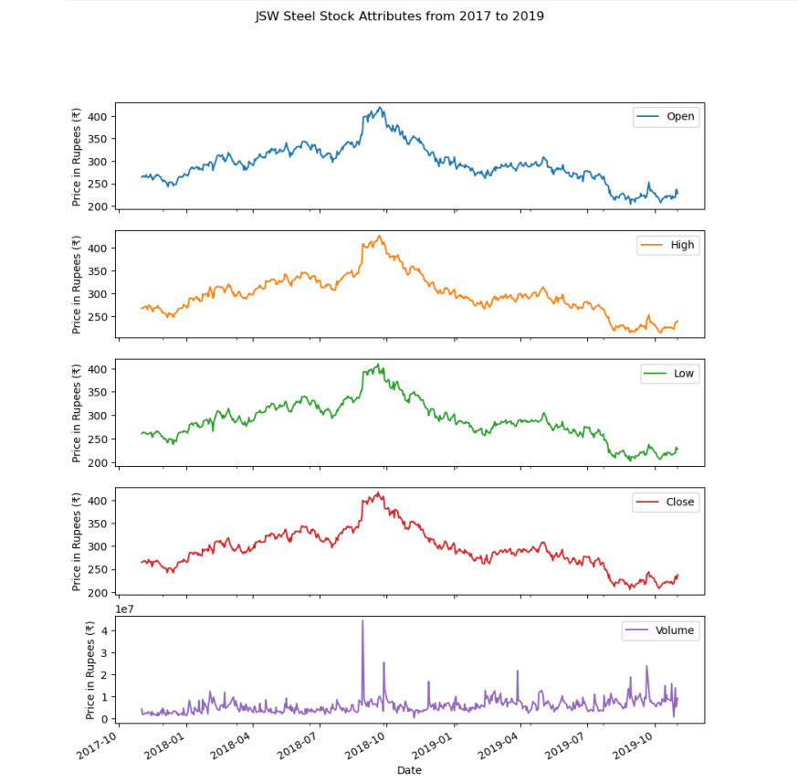
3.2 Visualizing the Attributes of our Datasets :
From the plot we can see the visualizing attributes of our dataset. And also we can know that In which month the stock price has been raised and dropped As we can see from above plots there is not much differences b/w them.

Slide 14
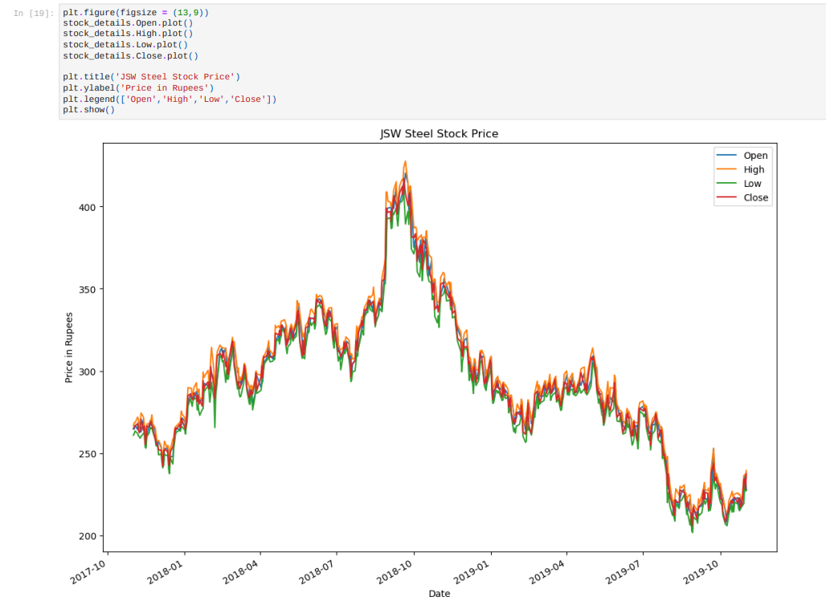
As we can see this plot is about 4 columns Open, High, Low, Close so there is no such difference b/w them they are almost same.
3.3 Visualization of Combine Dataset :

Slide 15
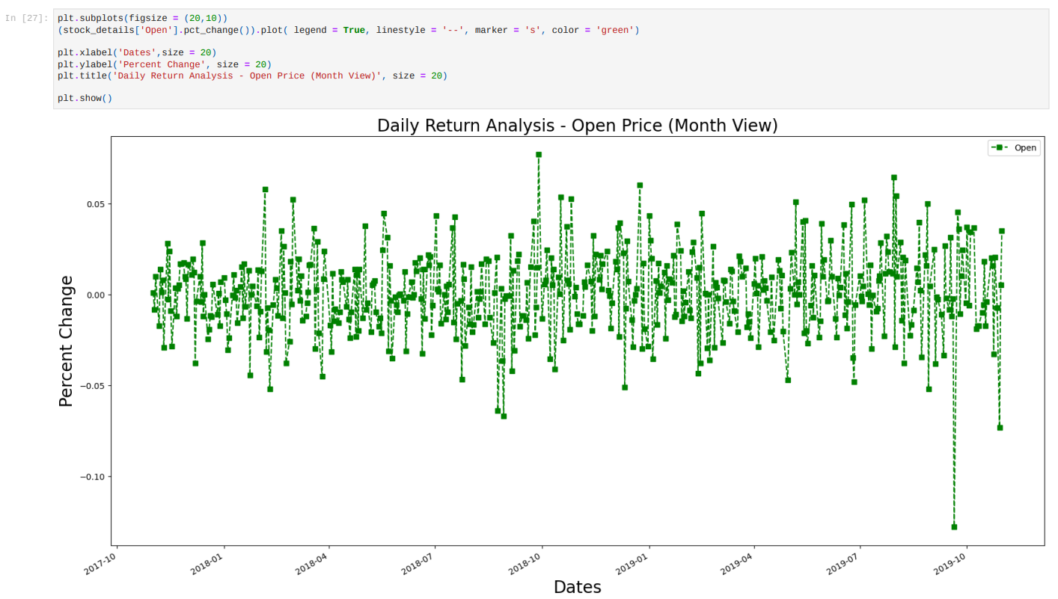
3.4 Daily Return Analysis for Open Price :
From the graph we can see the daily return analysis for Open Price in which the highest return we got approximate of 8% and the most lowest price for daily return approximate of -14% and it does not have more variations.

Slide 16
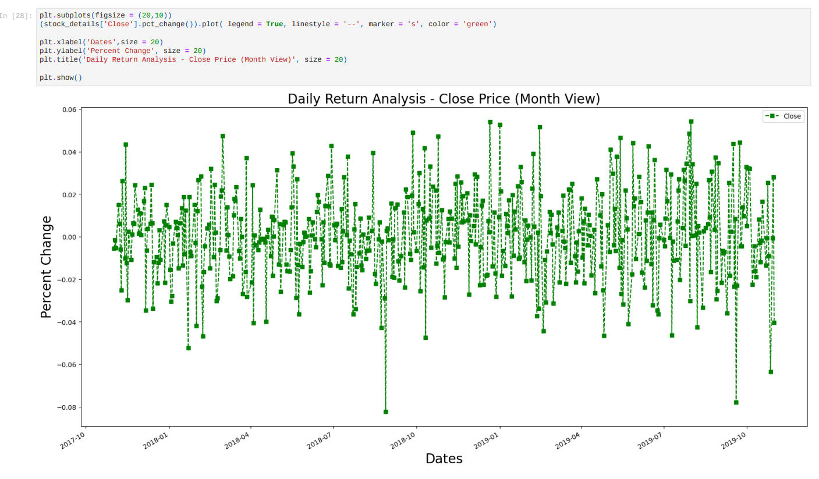
Daily Return Analysis for Close Price :
From the graph we can see the daily return analysis for Close Price in which the highest return we got above 4% multiple times and the most lowest price of -8% compare to open price closing price is better and it has more variations.

Slide 17
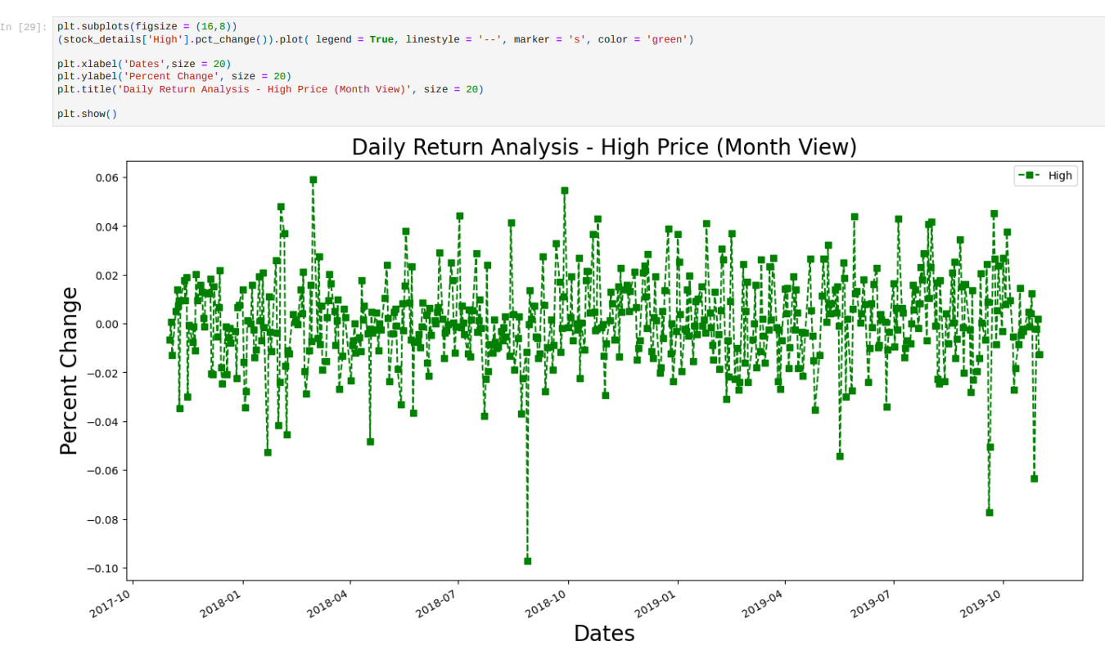
Daily Return Analysis for High Price :
From the above graph we can see the daily return analysis for High Price in which the highest return we got between 4% - 6% multiple days and the most lowest price of -10%.

Slide 18
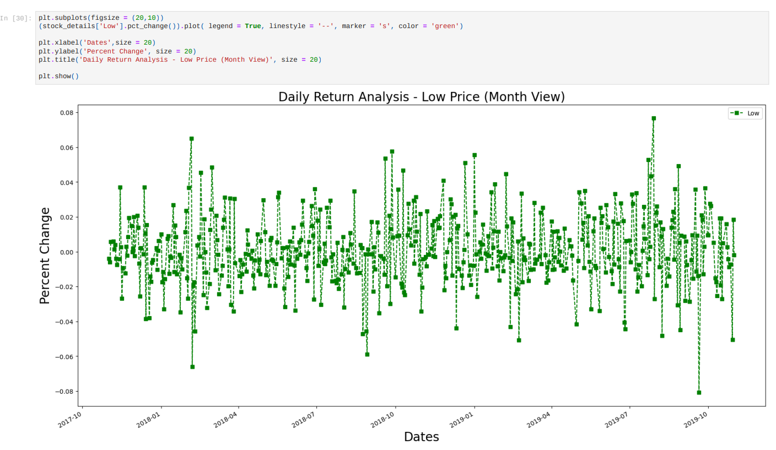
Daily Return Analysis for Low Price :
From the graph we can see the daily return analysis for Low Price in which the highest return we got 8% only for single day and the most lowest price more than -8% and most of days have got between 4% to 6%.

Slide 19
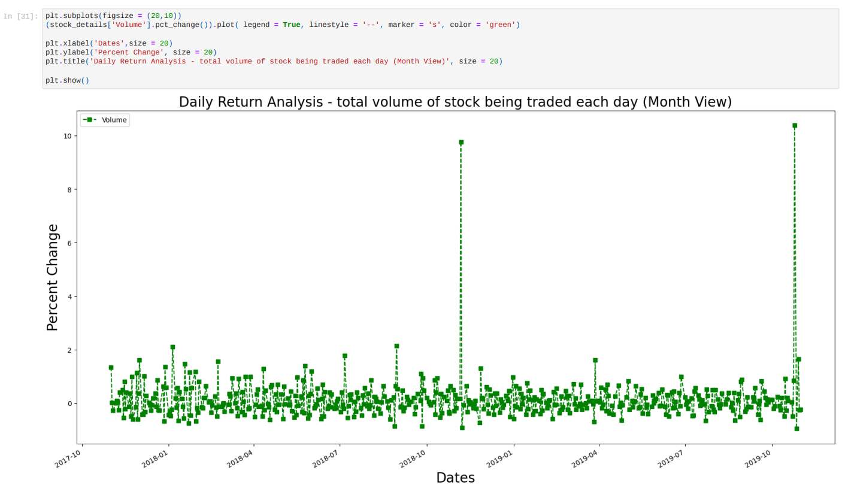
Daily Return Analysis for total volume of stock being traded each day :
From the above graph we can see the daily return analysis for Volume number of share trades in which we can see that between 2018-11 to 2018-12 the traders have increased up to 10% for a single day and in the 2019-10 to 2019-11 again it had increased more than 10% for a single day that means most of the days shares are lying only up to 2%.

Slide 20
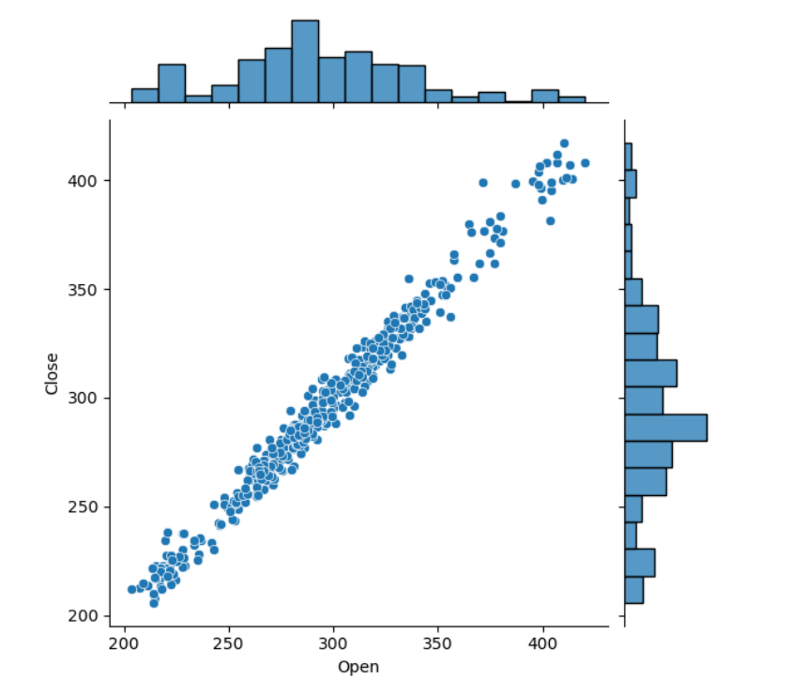
3.5 Compare the daily returns of Open and Close :
So now we can see that the two stocks of Open and Close are good correlated with each other and a linear relationship between its daily return values.

Slide 21
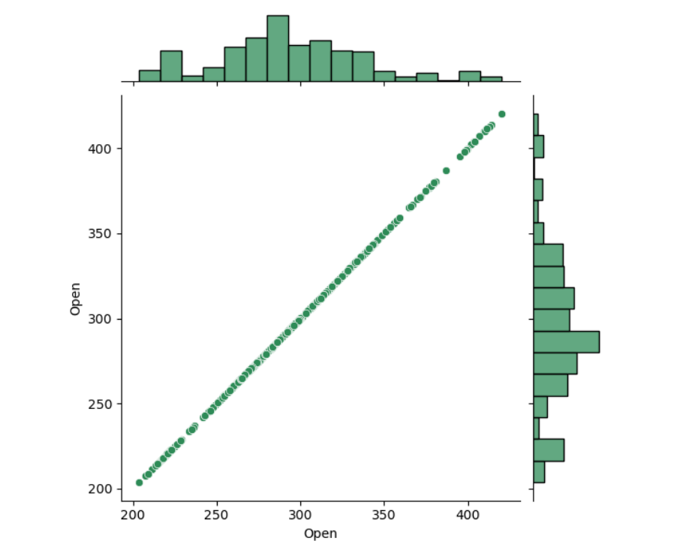
3.6 Comparing Open column itself should show a perfectly linear relationship :
From the Given graph we can see the comparison of its open column itself and its showing the perfect linear relationship.

Slide 22
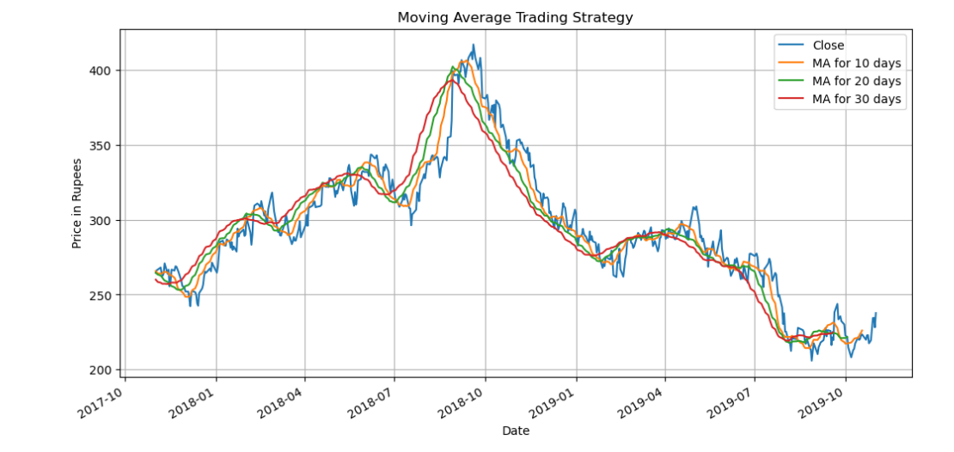
3.7 Moving Average ( MA ) Trading Strategy :
Moving averages are commonly used in technical analysis of stocks to predict the past and future price trends. A 10-day moving average is a powerful tool to know if prices are moving in an uptrend or a downtrend.
Mostly the MA for 10 days, 20 days,30 days are moving in uptrend till 2018-09 and till that stock price were on the rise.
By seeing above graph after 2018-09 there is continuous drop till 2019-02.
Then again it got raised and again it got dropped.

Slide 23
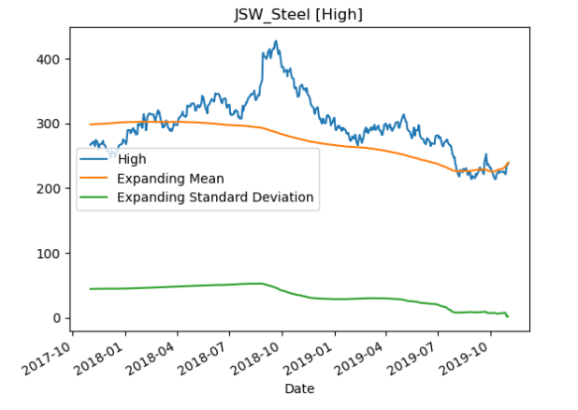
3.8 Expanding Window Method :
From the Given Expanding window method For JSW steel Data we can see that ,
From 2017-11 to 2018-01 " High " value was under mean for a period of time so we can say there was some loss.
After 2018-01 the 'High' value was above the mean and it got raised every month but in 2018-10 the price had reached more than 400 after that it had dropped but it was above mean line for long period and it was maintained continuously above mean line we can say that there was less loss and more profit.

Slide 24
4. Perform Assumption Check

Slide 25
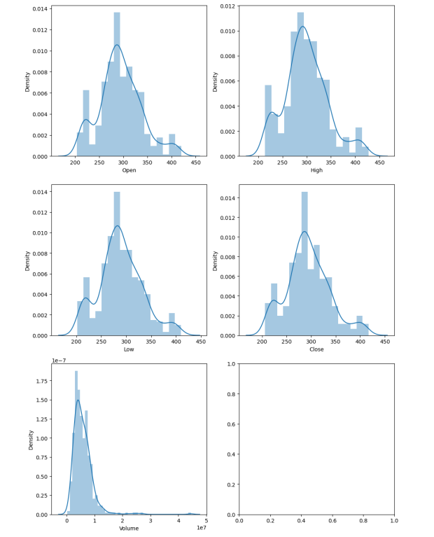
4.1 Normality / Distribution Test Using Distplot :
In the distribution plot of OHLC data, we can see two peaks which means the data has varied significantly in two regions and the Volume data is left-skewed.

Slide 26
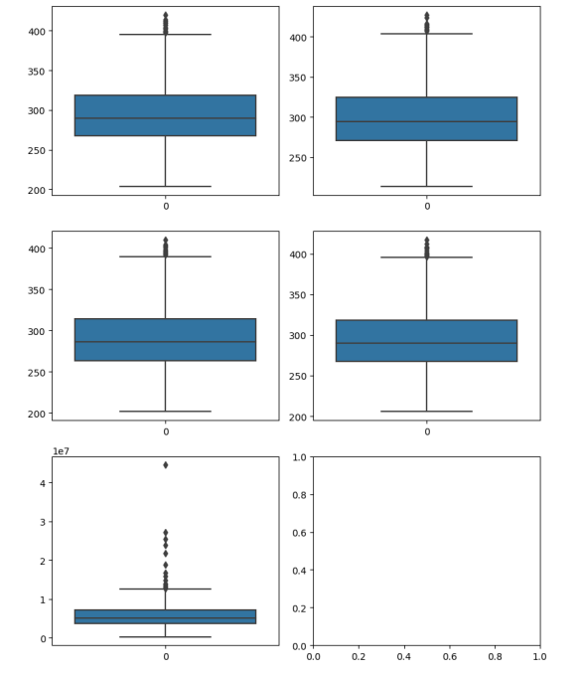
4.2 Outlier Test Using Box Plot :
From the above boxplots, we can conclude that for every data there is a outliers.

Slide 27
5. Down Sample Data

Slide 28
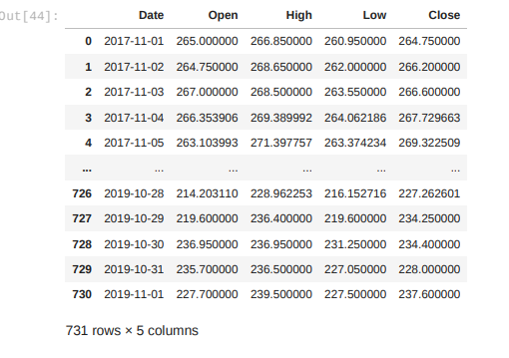
5.1 Converted to Daily Data Using Down sampling :
The Dataset of 2 years was not completely available so to so we down sample the data and used polynomial method and then converted into completely daily data.

Slide 29
6. Applying Neural Network

Slide 30
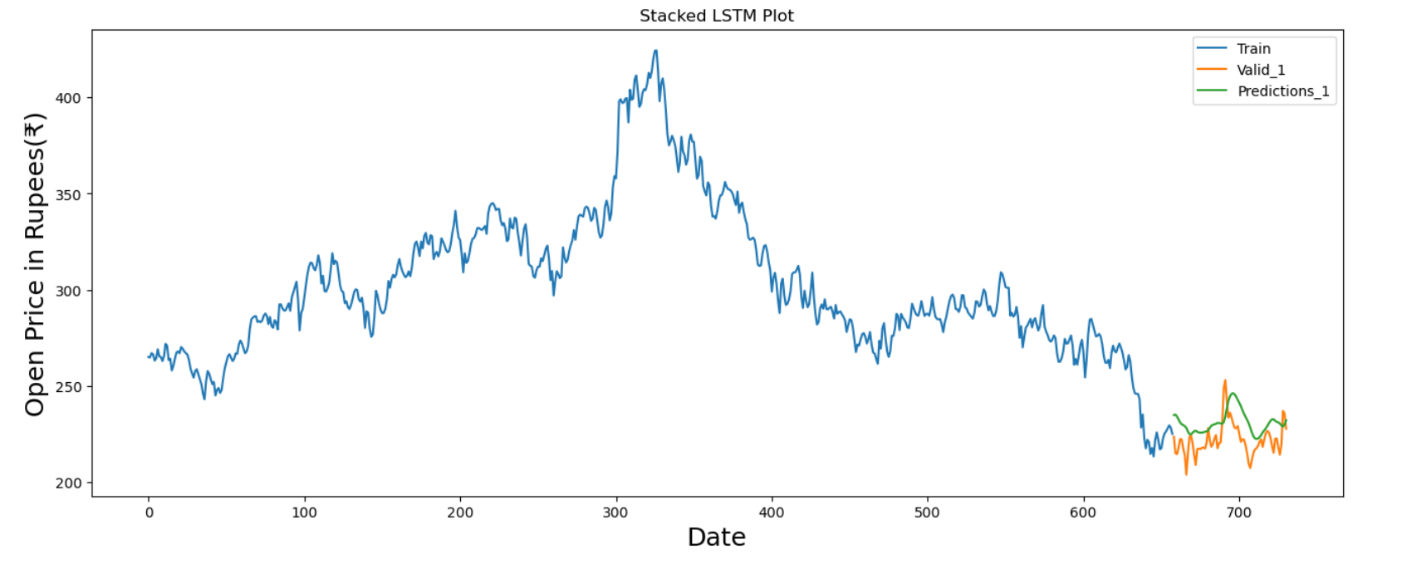
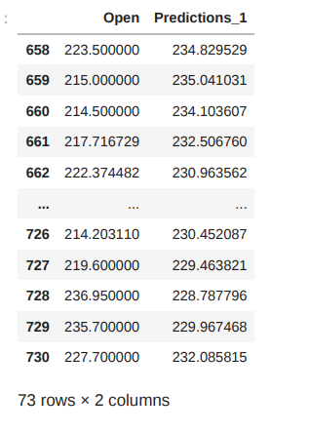
MODEL 1 - Stacked LSTM :

Slide 31
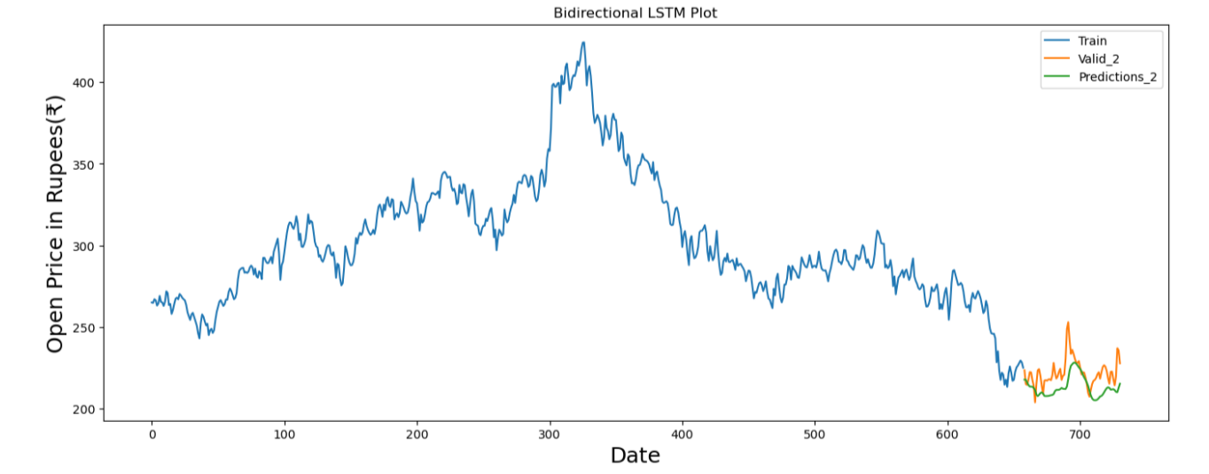
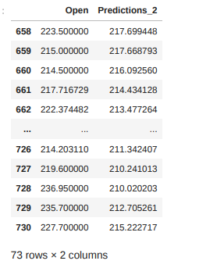
MODEL 2 - Bidirectional LSTM :

Slide 32
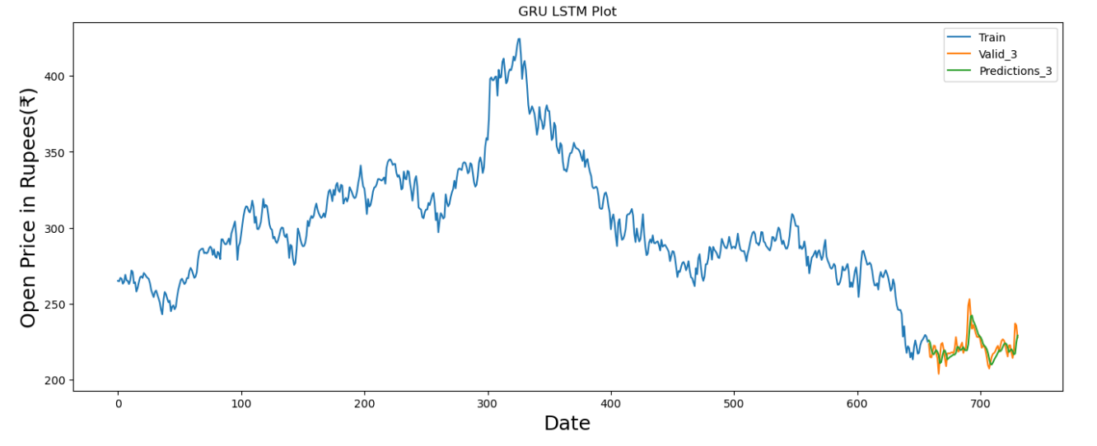
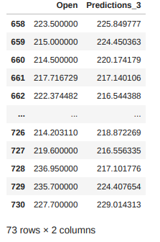
MODEL 3 - GRU (Gated Recurrent Unit) LSTM :

Slide 33
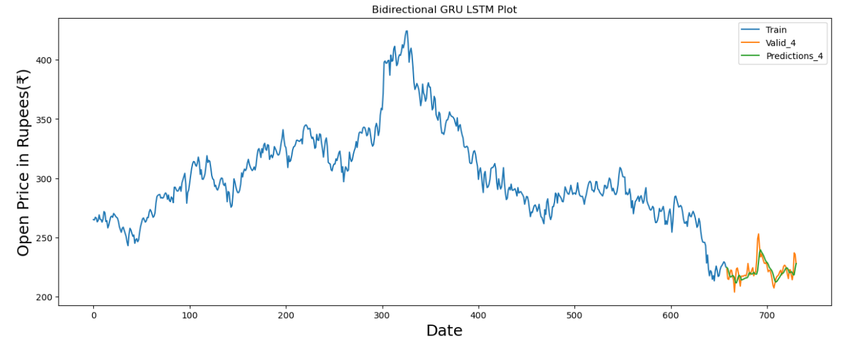
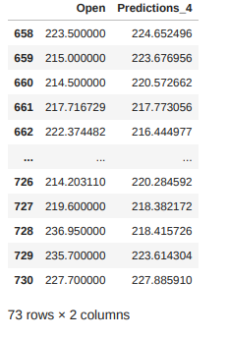
MODEL 4 - BGRU (Bidirectional GRU) LSTM :

Slide 34
7. Data Driven Forecasting Methods

Slide 35
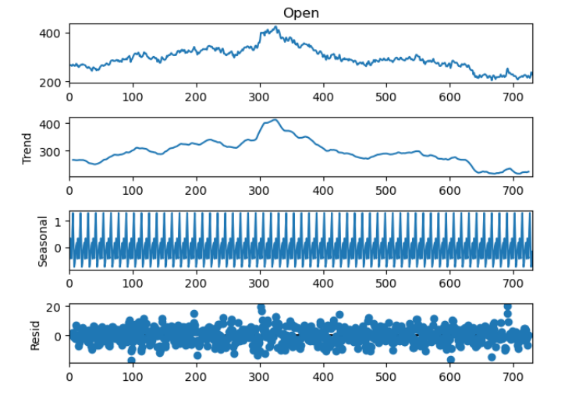
7.1 Time series decomposition plot :

Slide 36
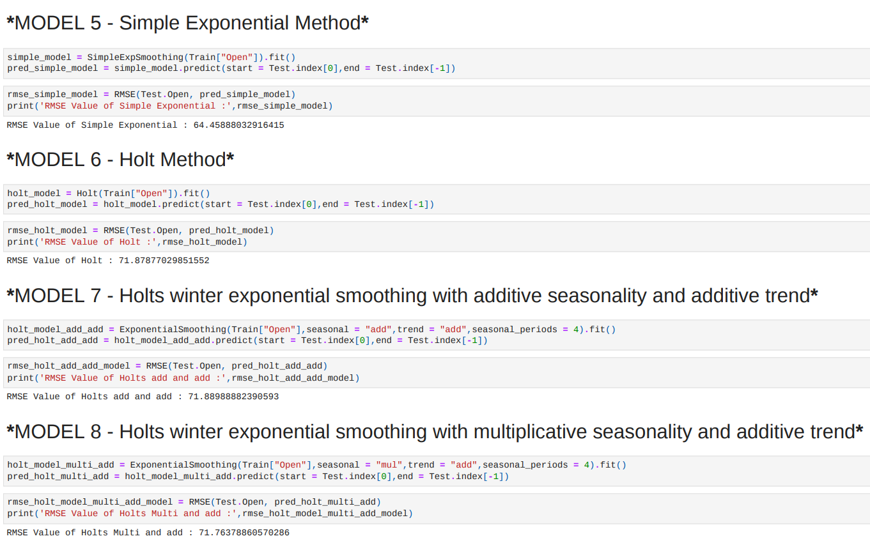
7.2 Models :

Slide 37
8. Model based Forecasting Methods

Slide 38
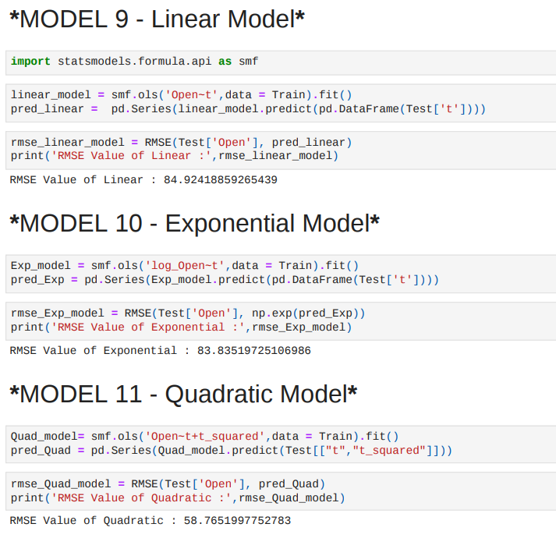
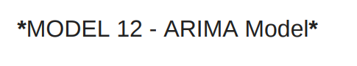
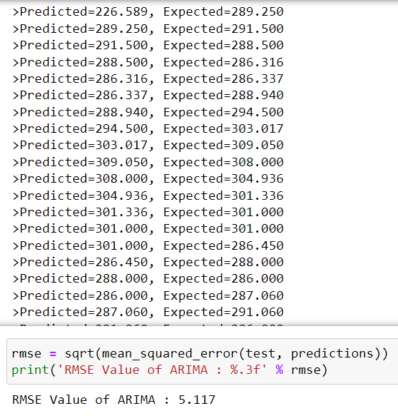
8.1 Models :

Slide 39
9. Future Fore caste Using LSTM

Slide 40
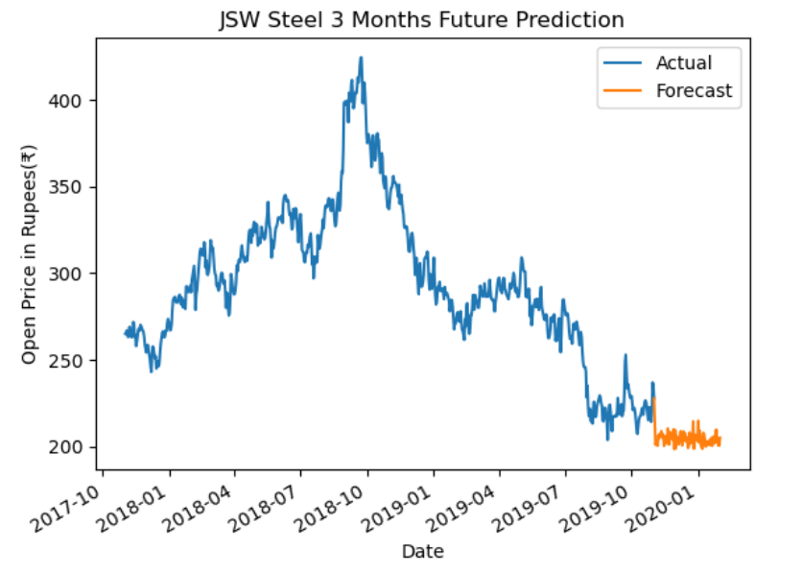
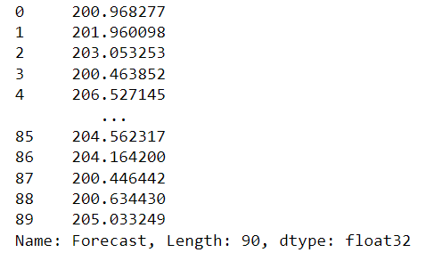
9.1 Future Fore caste Model For 3 Months Using LSTM Method :
We have taken past 6 months of data and predicted for 3 months of future prediction and we can see from graph that the future prediction is going low.
Future Predicted Price

Slide 41
Conclusion

Slide 42
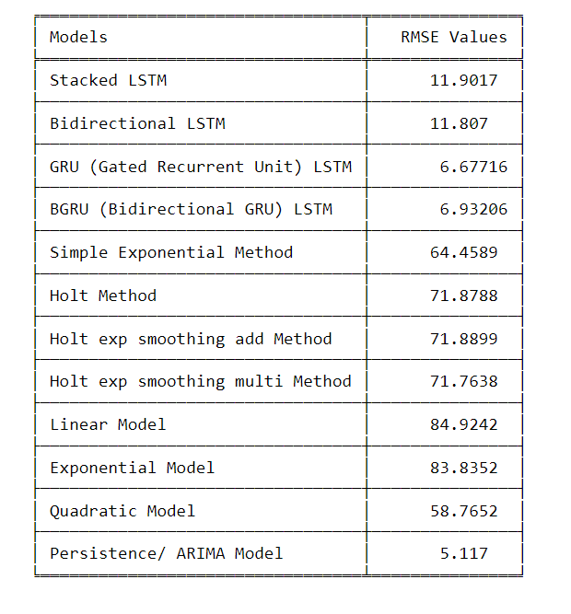
Data frame :

Slide 43
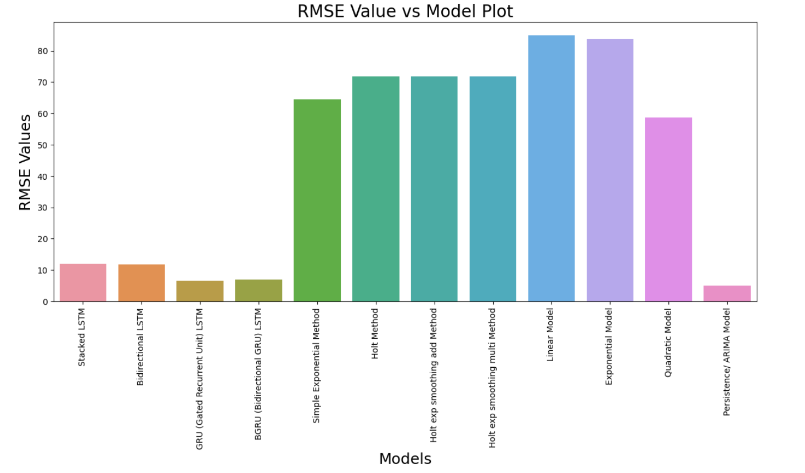
Graph :

Slide 44
Deployment

Slide 45
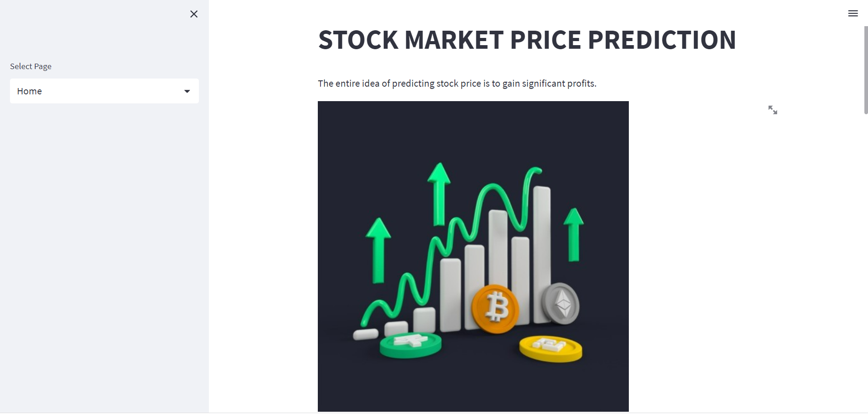
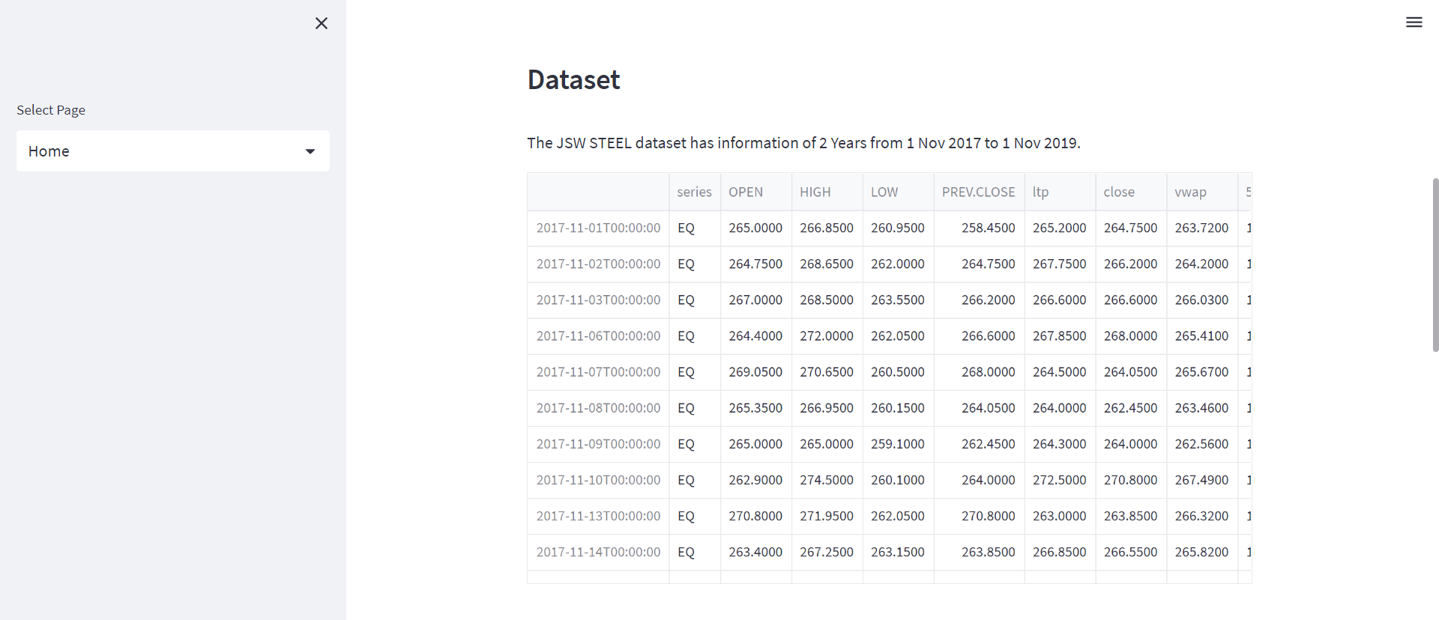
Home Page :

Slide 46
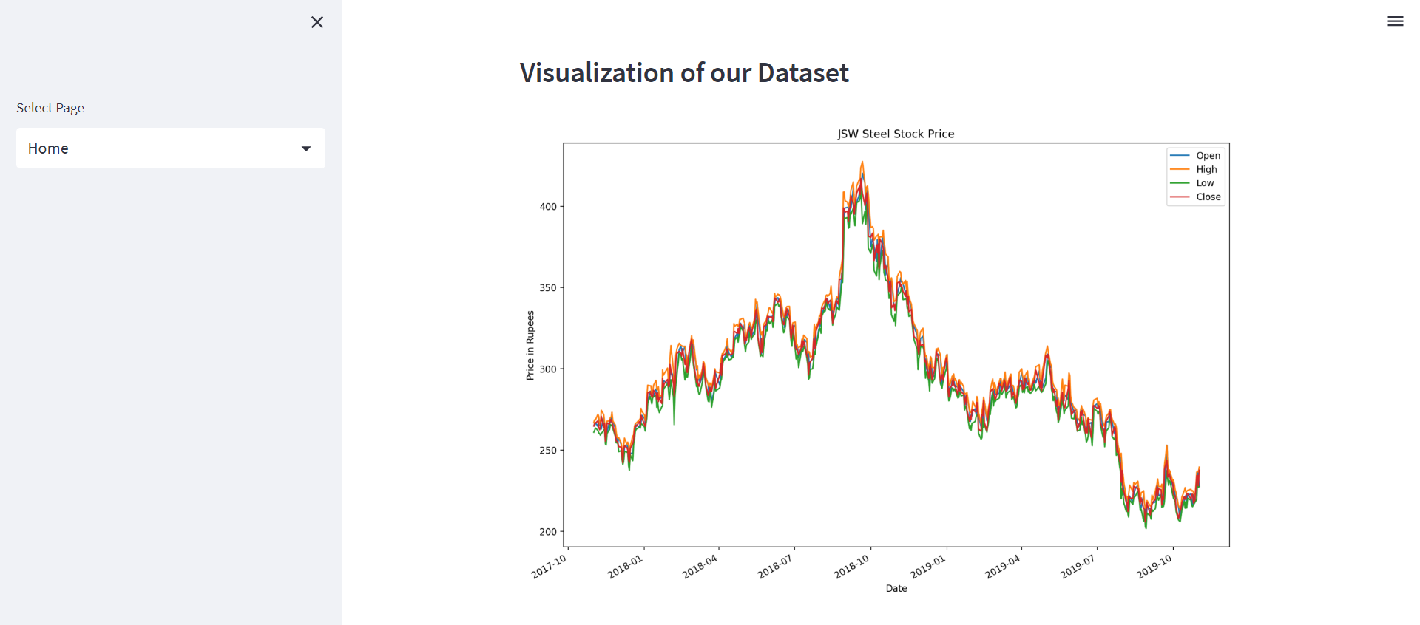
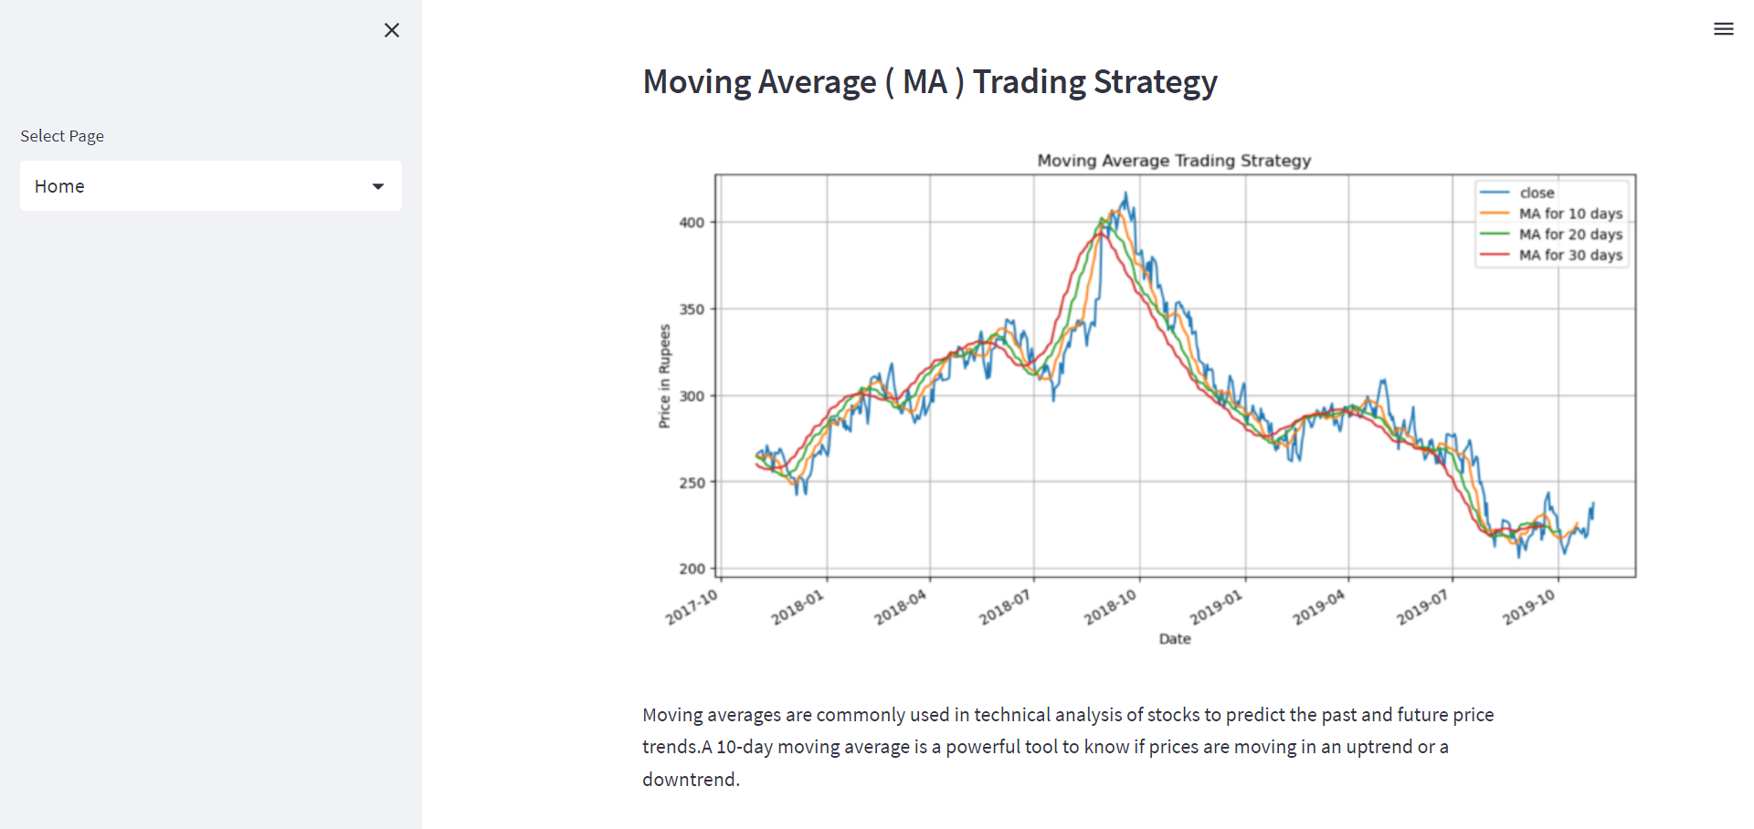

Slide 47
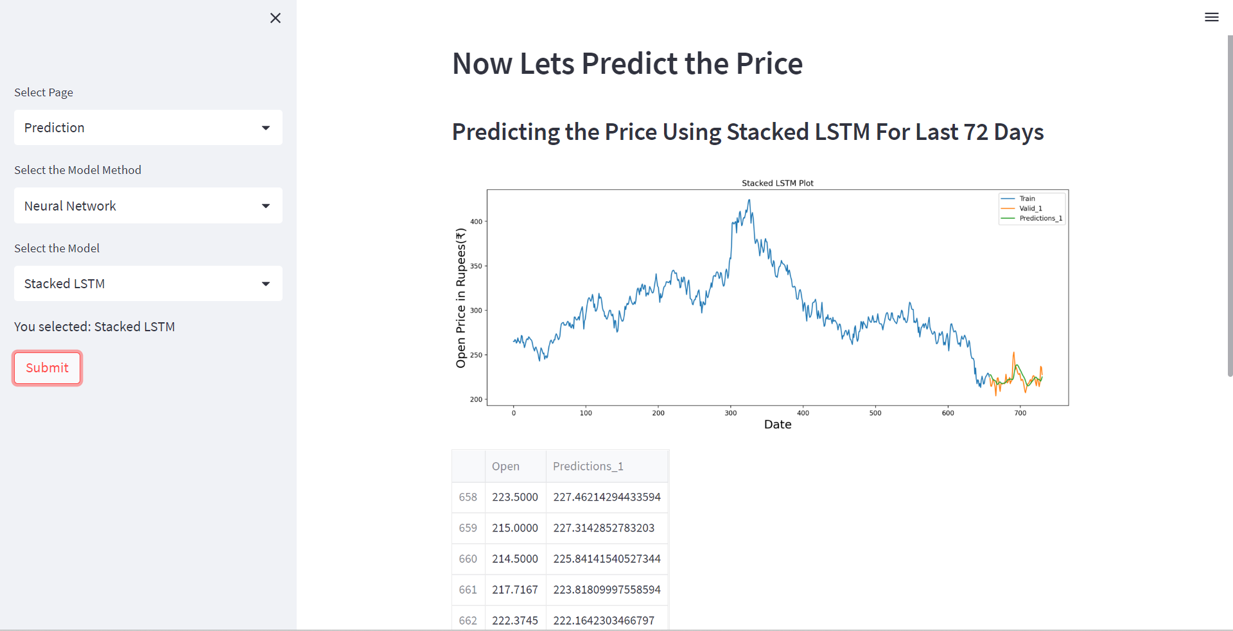
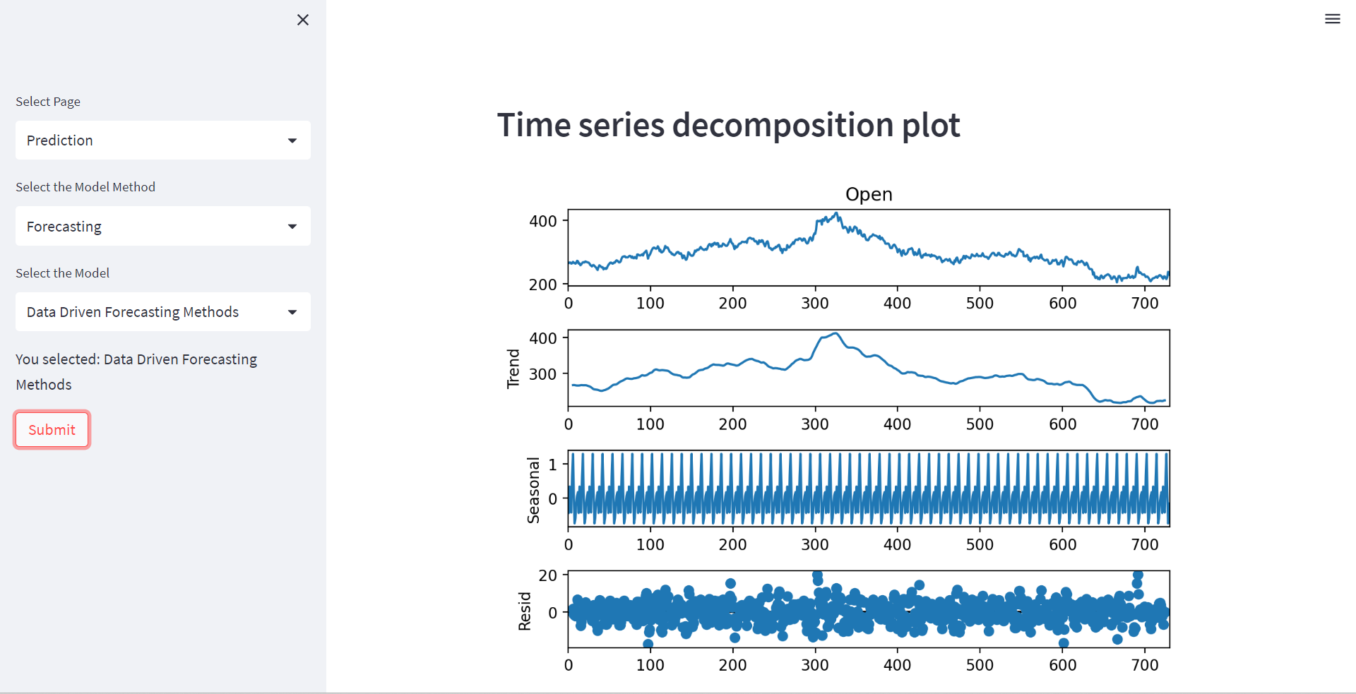
Prediction Page :

Slide 48
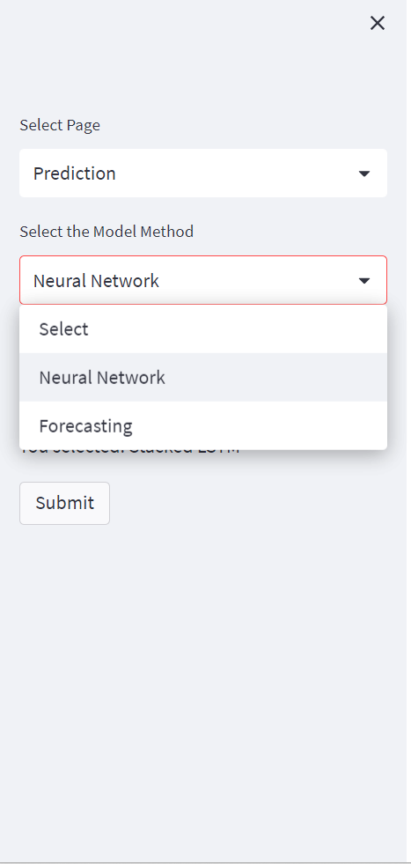
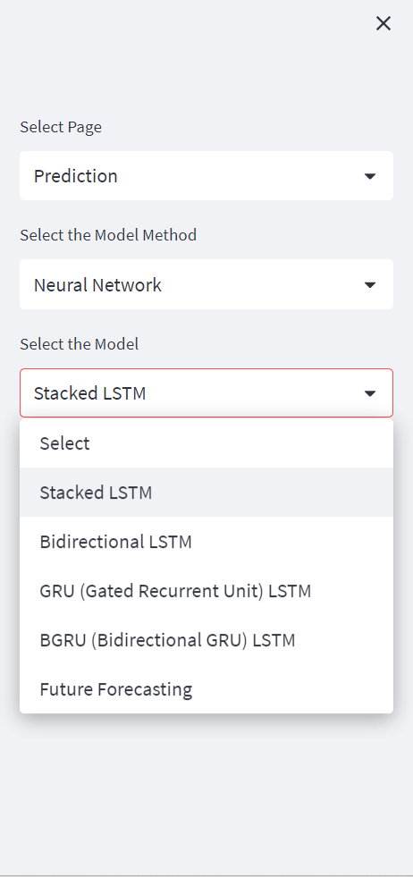
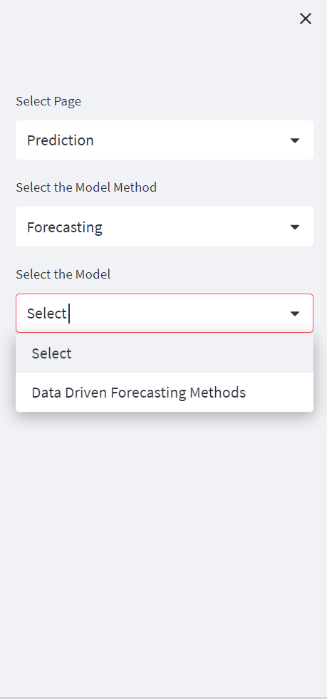

Slide 49
Thank You

